Slide 1


Slide 2
Timing Diagram
UML (Unified Modeling language)

Slide 3
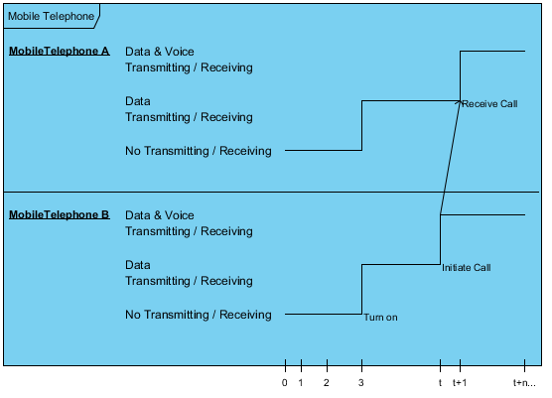
How Timing Diagram Looks Like?

Slide 4
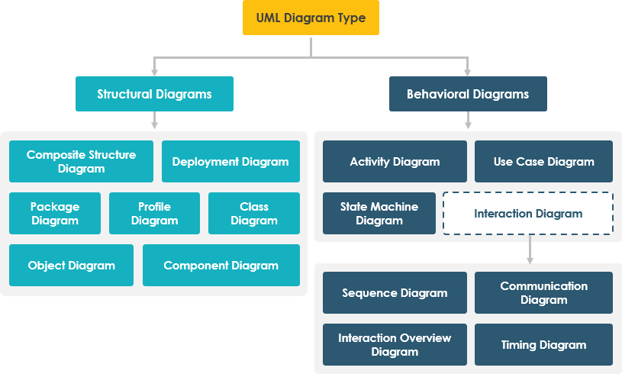
Timing Diagram

Slide 5
What is Timing Diagram?
A timing diagram is a specific UML behavioral modeling diagram that focuses on timing constraints.
It show’s how objects interact with each other during a certain period of time.
In a timing diagram, time passes on the x-axis from left to right, with different components of the system that interact with each other on the y-axis.

Slide 6
What is Timing Diagram?
Timing diagrams show how long each step of a process takes.
We use timing diagram to identify which steps of a process require too much time and to find areas for improvement.

Slide 7
Benefits of Timing Diagram
One of the key benefits of a UML timing diagram is that it gives users an overview of what goes on in a system or piece of software.
More critically, it shows which steps in a system take too much time, and this information can be used by business users and developers alike to improve their processes.
With timing diagrams, we can easily diagram a process and identify the major steps it takes to complete the process.

Slide 8

Timing Diagram Basic Symbols
Symbol Name: Lifeline
Description: A lifeline in a Timing Diagram forms a rectangular space within the content area of a frame. Lifeline is a named element which represents an individual participant in the interaction. It is typically aligned horizontally to read from left to right.

Slide 9
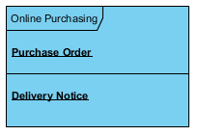
Timing Diagram Basic Symbols
Multiple lifelines may be stacked within the same frame to model the interaction between them.

Slide 10
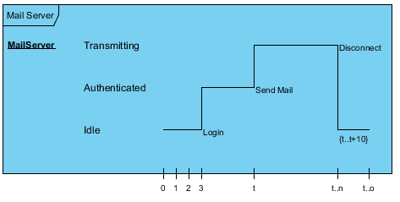
Timing Diagram Basic Symbols
Operation/System Name
States
Duration
Lifeline
Stimuli
Time Unit
Notes:
Stimuli= a thing or event that evokes a specific functional reaction

Slide 11
Example : Mobile Telephone System
How to Draw timing diagram

Slide 12
Example

Slide 13
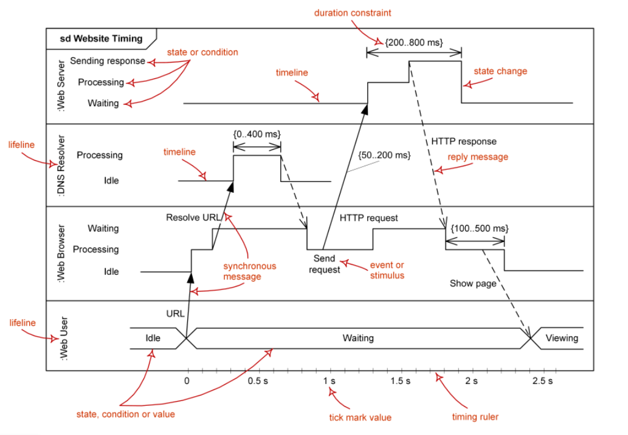

Slide 14
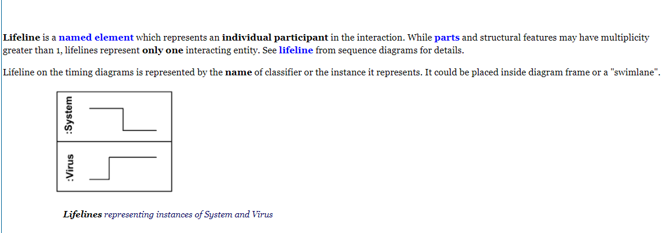

Slide 15
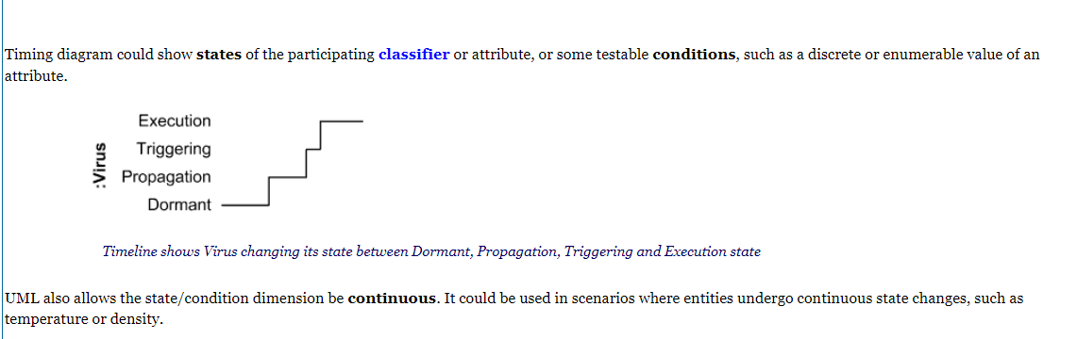
State

Slide 16
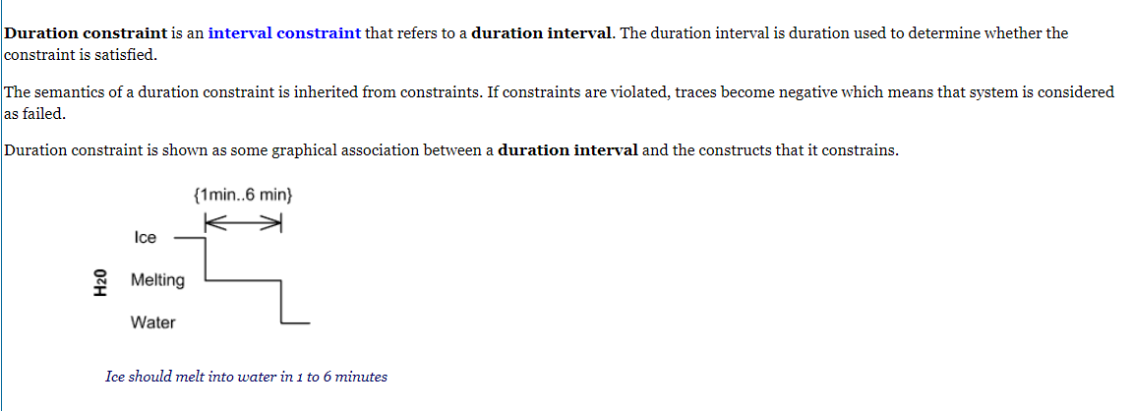

Slide 17
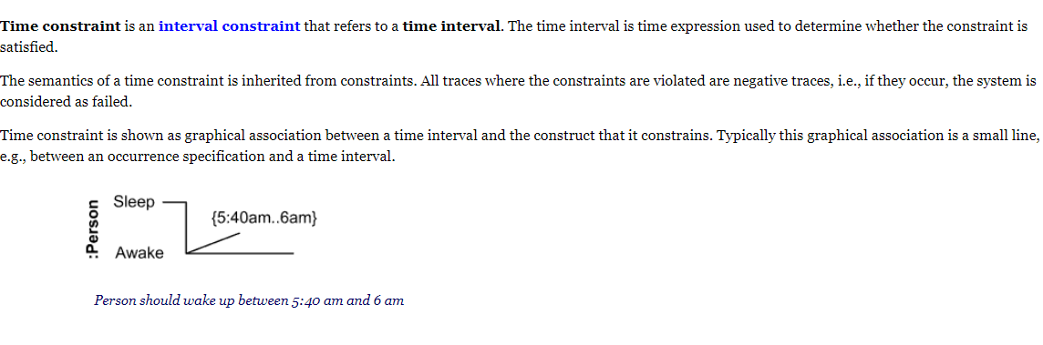

Slide 18
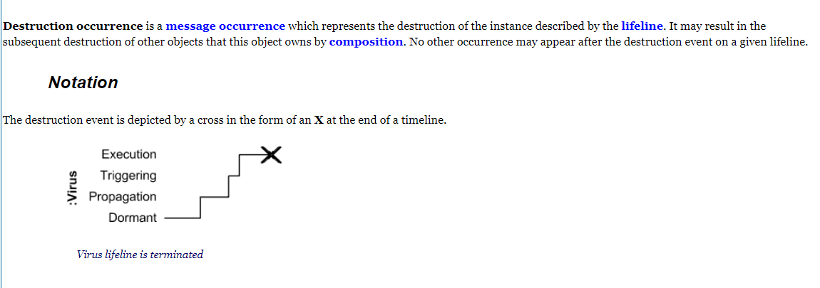

Slide 19
Class Task
A user wants to purchase a book online. After entering the URL on google chrome, it should take 0.5 seconds for http request. Chrome will then send a request to DNS server. DNS server will then contact web server for its response. Google chrome should take 0.5 second to open and DNS processing should take 1 second. DNS time for sending request to webserver should be 3 second.
Draw a timing diagram for the above scenario.

Slide 20
No Impairment, Normal State It is the stage where the memory and cognitive abilities look normal.
Normal Aged Forgetfulness It is mostly seen in people with an age group of 65 who experience subjective complaints of cognitive and/or functional difficulties, which means they face problems in recalling the name and past 5 to 10 years of history.
Early Confusional, Mild Cognitive Impairment It causes a problem in retrieving words, planning, organizing, objects misplacing as well as forgetting fresh learning, which in turn affects the surrounding.
Late Confusional, Mild Alzheimer's In this, a person forgets the most recent events and conversations. The person remembers himself and his family, but face problems while carrying out sequential tasks such as cooking, driving, etc. Its duration is about two years,
Early Dementia, Moderate Alzheimer's In this, the person cannot manage independently. He faces difficulty in recalling the past details and contact information. It lasts for about 1.5 years.
Middle Dementia, Moderately Severe Alzheimer's It leads to insufficient awareness about current events, and the person is unable to recall the past. It causes an inability in people to take a bath and dress up independently. It lasts for about 2.5 years approximately.
Late or Severe Dementia, Failure to Thrive It is severely limited intellectual ability. In this, a person either communicates through short words or cries, which leads health to decline as it shut down the body system. Its duration is 1 to 2.5 years.

